Slide 1
Shooting Star Sports Club Organogram
Executive Chairman
Chief Operating Officer
Graphics
Head of Admin
Admin Assistants
Media Lead
Photographer
Videographer
Sporting Director
Director, Finance & Accounts
Head Coach
Ass Coach 1
Ass Coach 2
Ass Coach 3
Goalkeeper Trainer
Strength & Conditioning Coach
Match & Performance Analyst
Psychologist
Medical Team
Doctor
Nurse
Physiotherapist
Masseur
Backroom Staff
Team Manager
Team Coordinator
Kits & Equipment
Player Scout
Players
Accountant
Finance Assistant
Youth Corper
Drivers
Dispatch Riders
Cleaners
Security

Slide 2
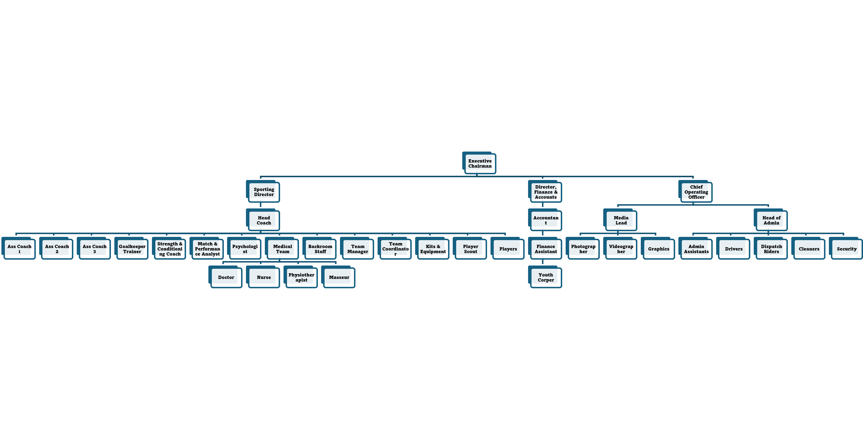
3SC ORGANOGRAM

